Slide 1

Credit Card Churn Prediction
ADVANCED DATA SCIENCE CAPSTPNE:
Alif Sussardi, 15th January 2021

Slide 2
Credit Card Churn Characteristics
As a credit card issuer, it is important:
know whether customer continue transactions → keep using our service.
So, we can do strategies:
Give promo/gift ?
Benefit?

Slide 3
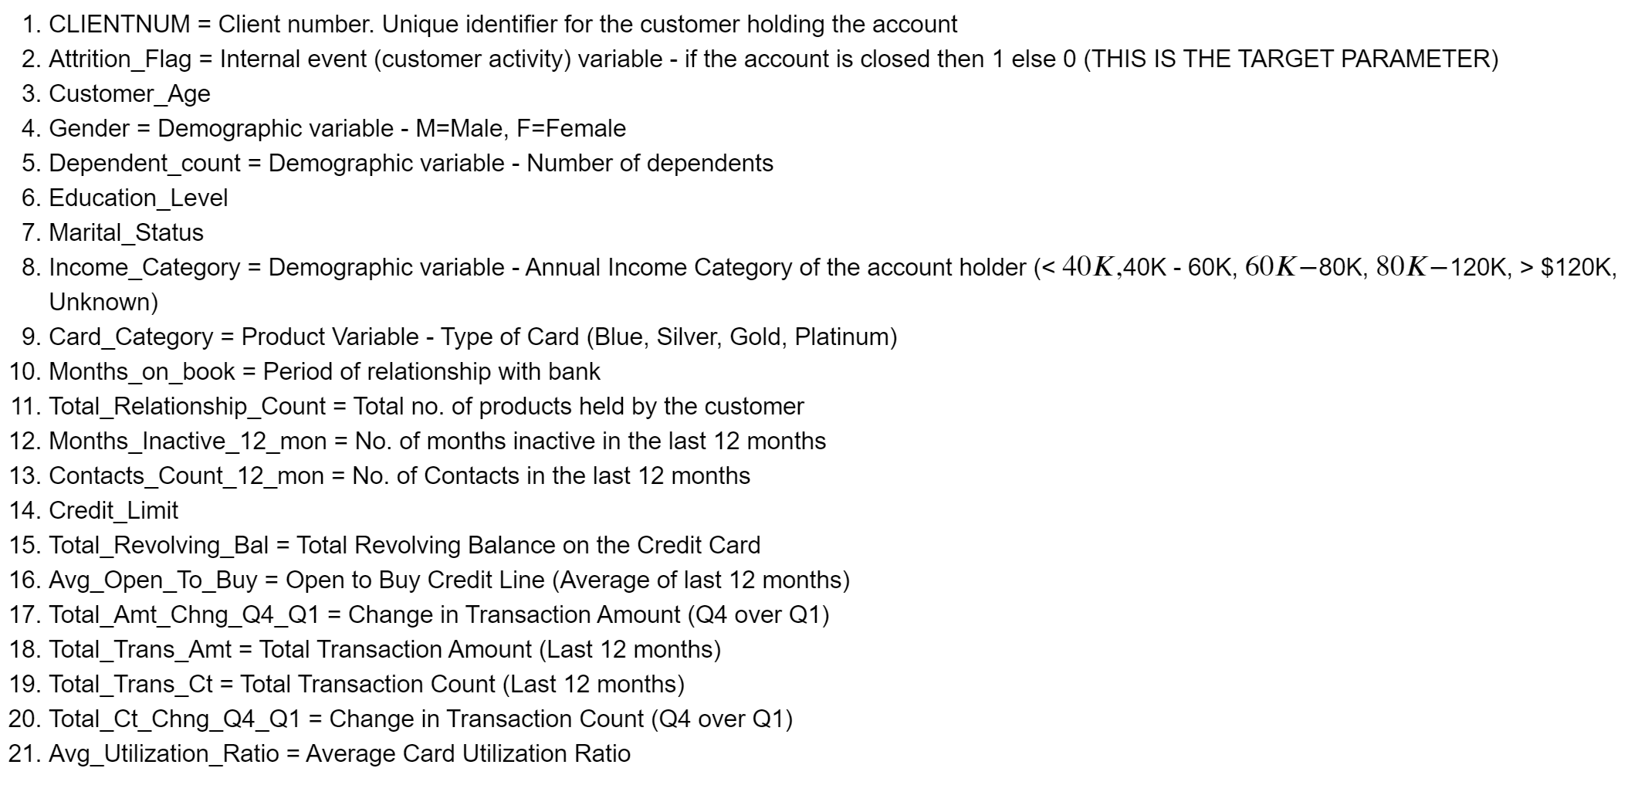
Datasets
The data was obtained from Kaggle:
https://www.kaggle.com/sakshigoyal7/credit-card-customers
The data contains 21 Parameters, including:

Slide 4
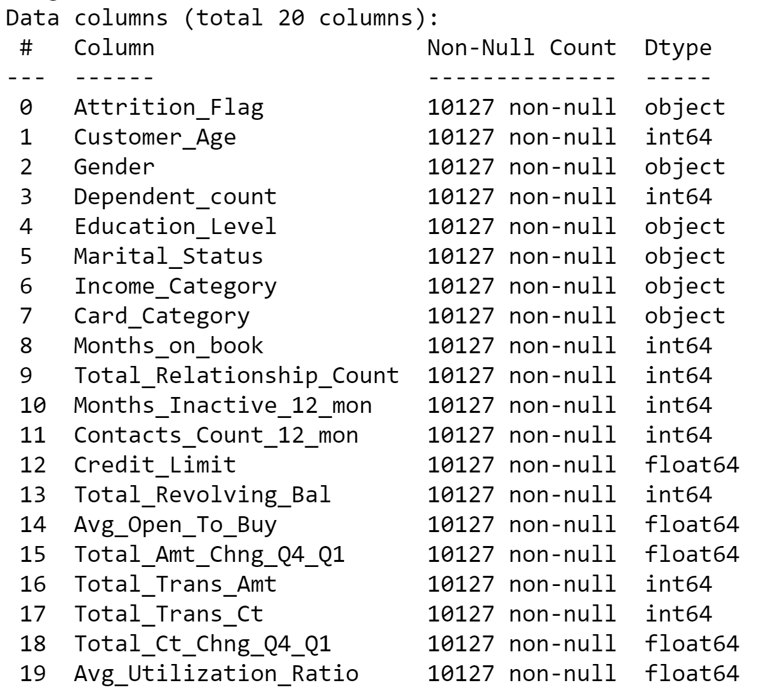
Datasets
The data are pretty good, and does not contains Null.

Slide 5
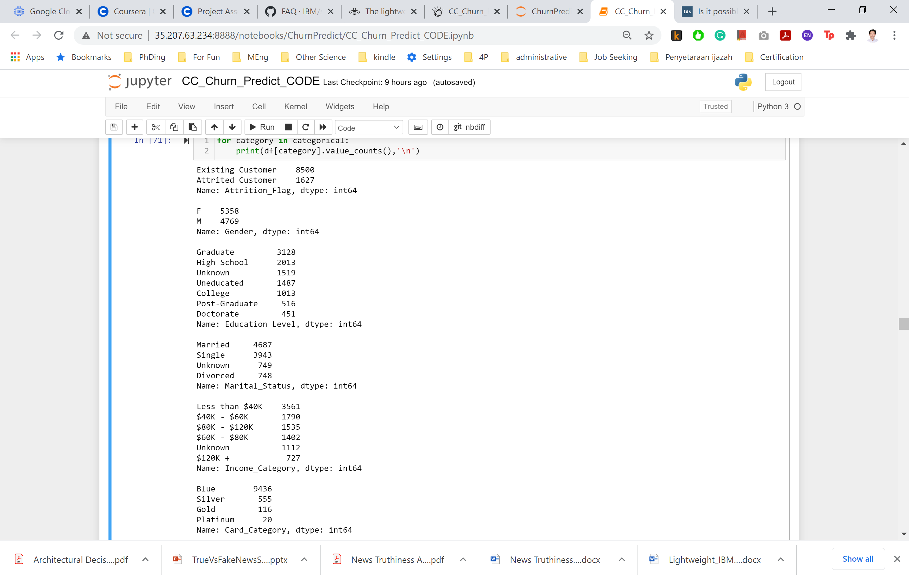
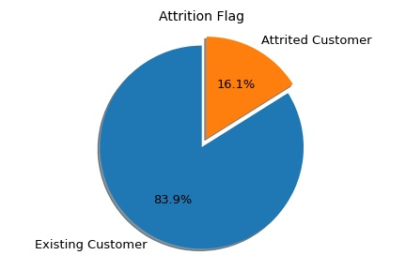
Datasets
The data are also does not contain wrong labels:

Slide 6
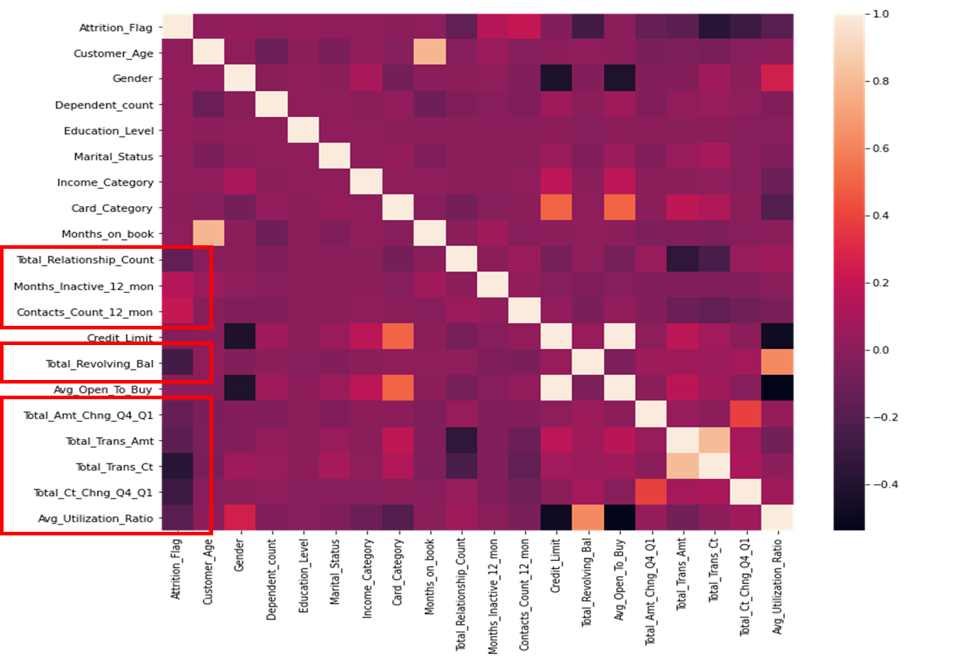
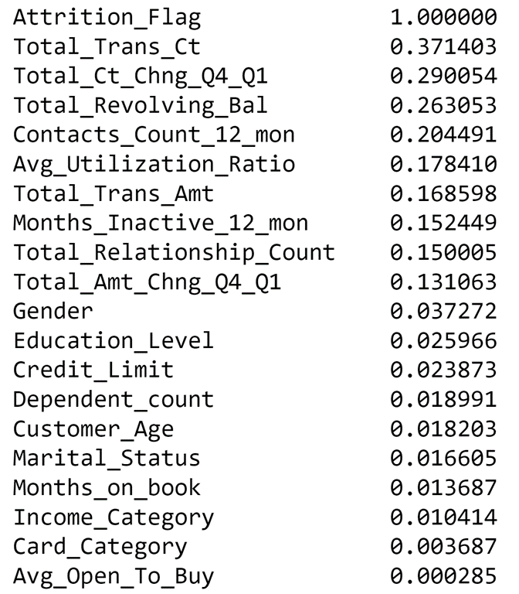
Datasets
The correlation matrix:

Slide 7
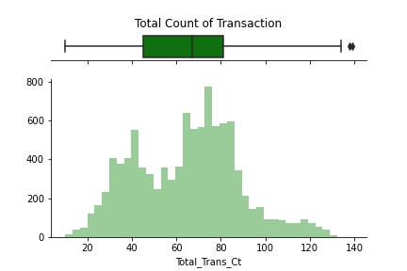
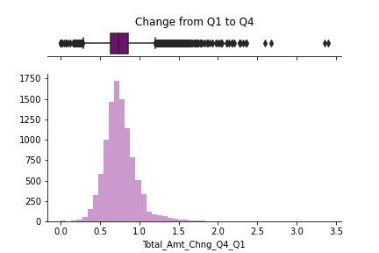
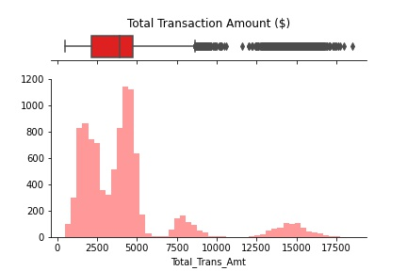
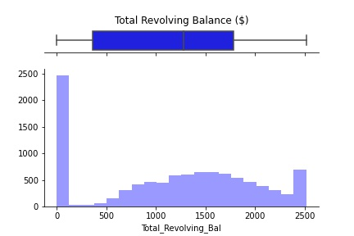
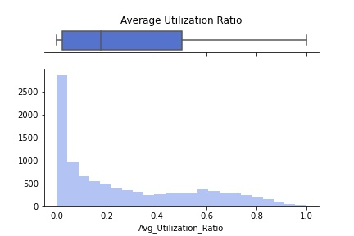
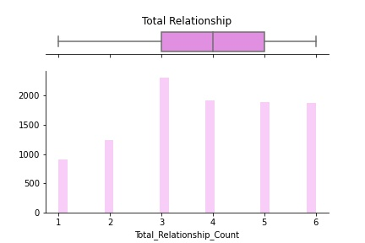
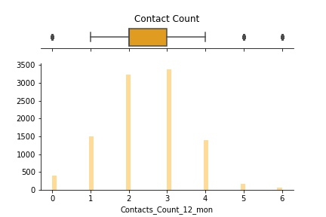
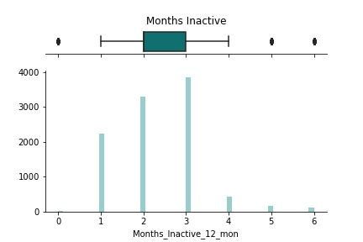
Datasets
?

Slide 8
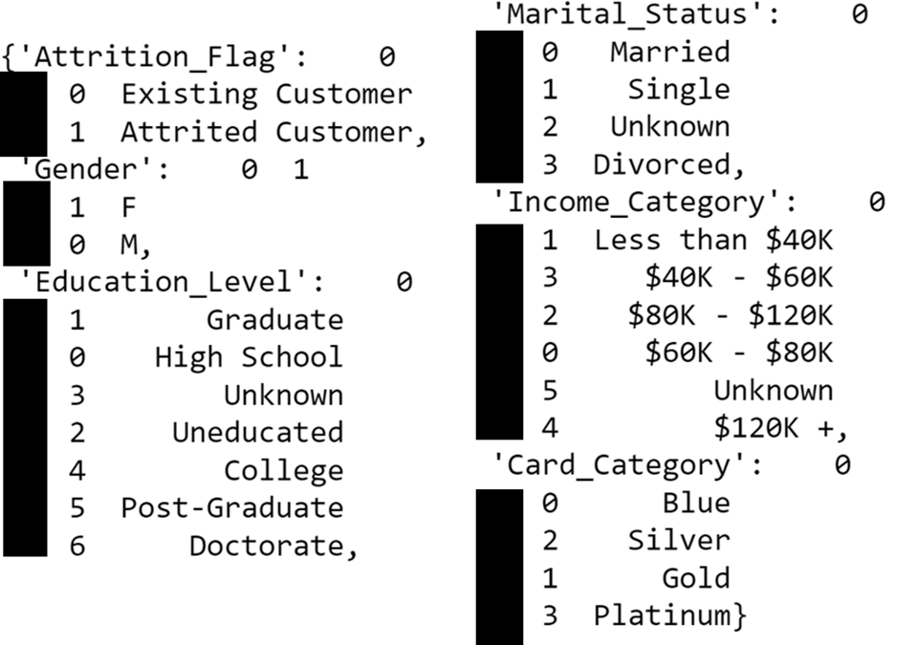
Extract, Transform & Load (ETL)
Data imported from *.csv
Loaded, transformed using pandas and numpy
Encode the categorical data:

Slide 9
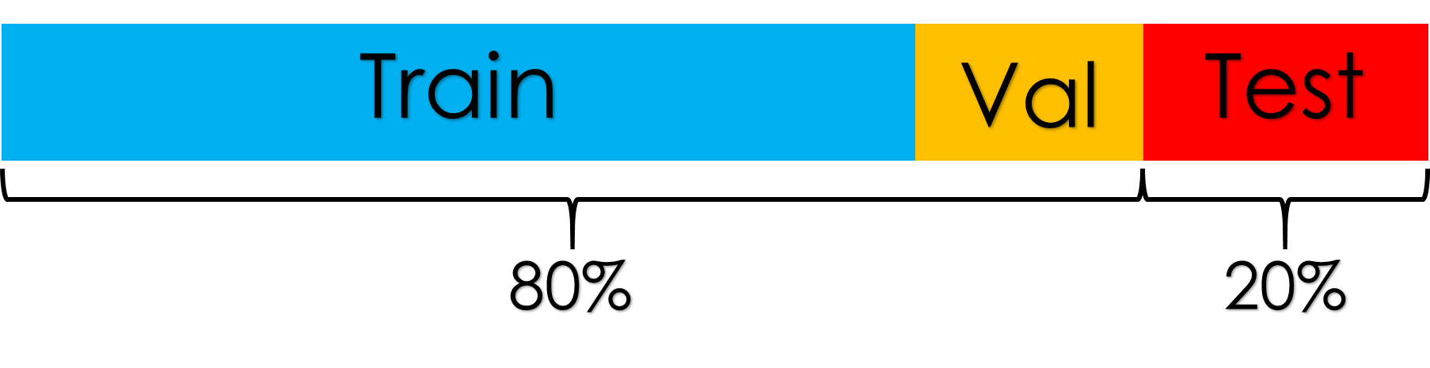
Extract, Transform & Load (ETL)
Scaling data using sklearn MinMaxScaler
Not all parameters are Normally distributed
Train Test data splitting sklearn train_test_split, ratio = 4:1
Train dataset splitted to Train and Validation, ratio = 4:1

Slide 10
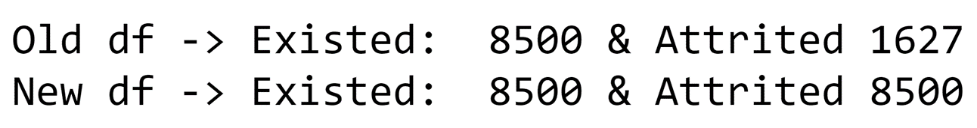
Extract, Transform & Load (ETL)
For Neural Network, SMOTE over-sample was tried to the Attrition Flag:
Total data = 1627 → 8500 as Attrited & 8500 as Attrited
The overall data split (Train, Test, Val) are still the same.
Train
Val
Test

Slide 11
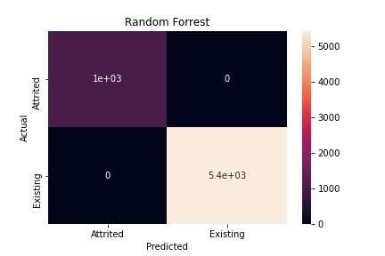
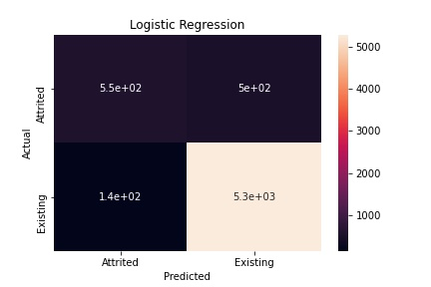
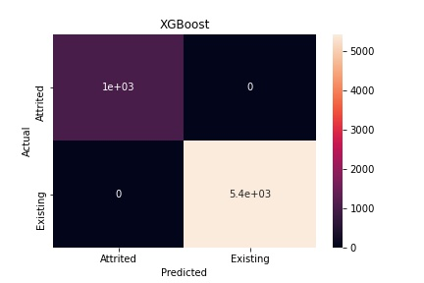
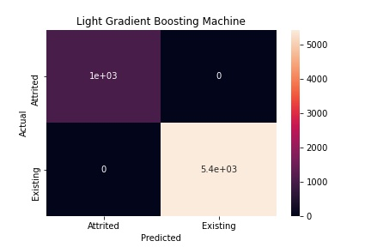
Machine Learning Algorithm
Random Forest Classifier
Logistic Regression
XGBoost Classifier
LGBM Classifier

Slide 12
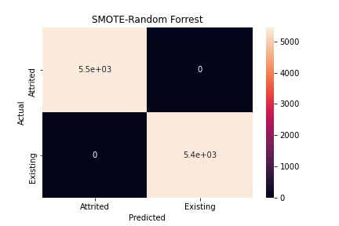
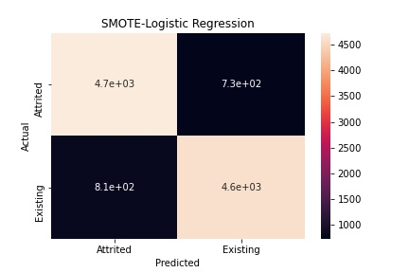
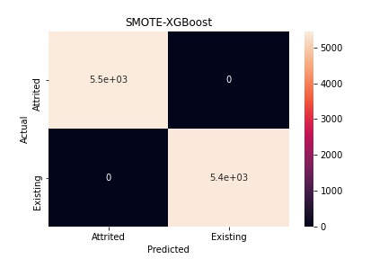
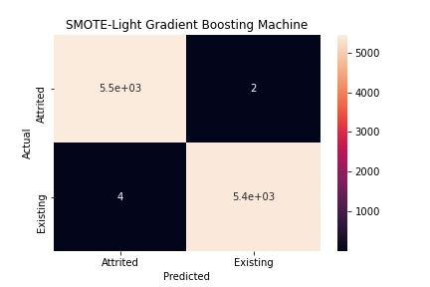
Machine Learning Algorithm (SMOTE)
SMOTE-Random Forest Classifier
SMOTE-Logistic Regression
SMOTE-XGBoost Classifier
SMOTE-LGBM Classifier

Slide 13
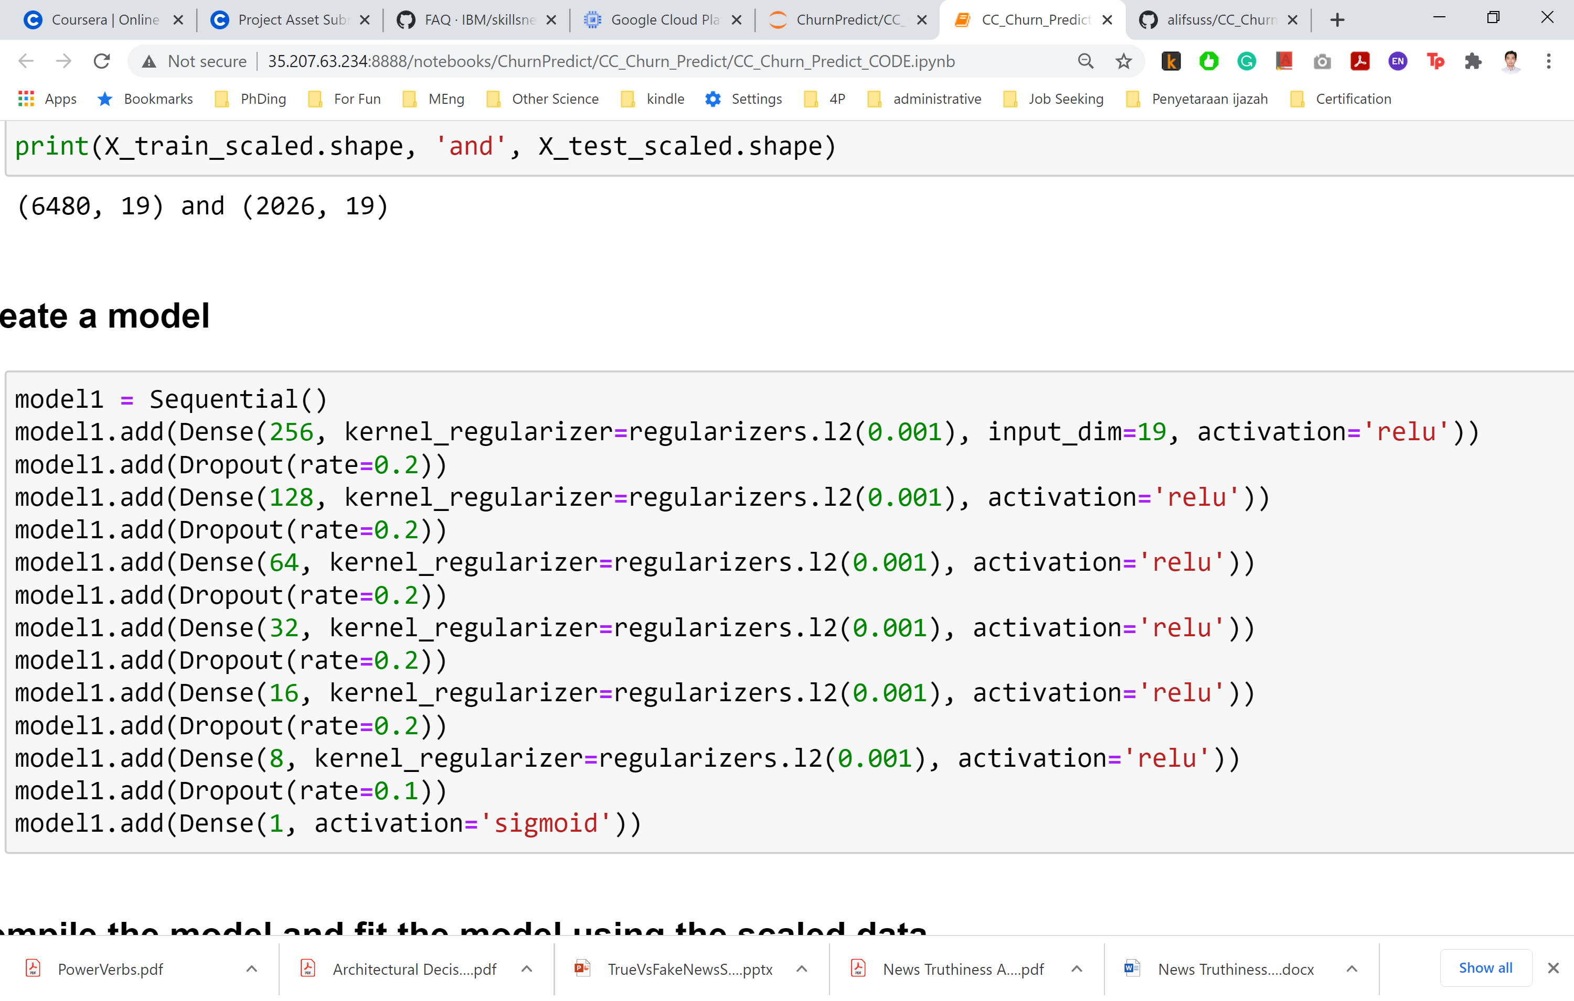
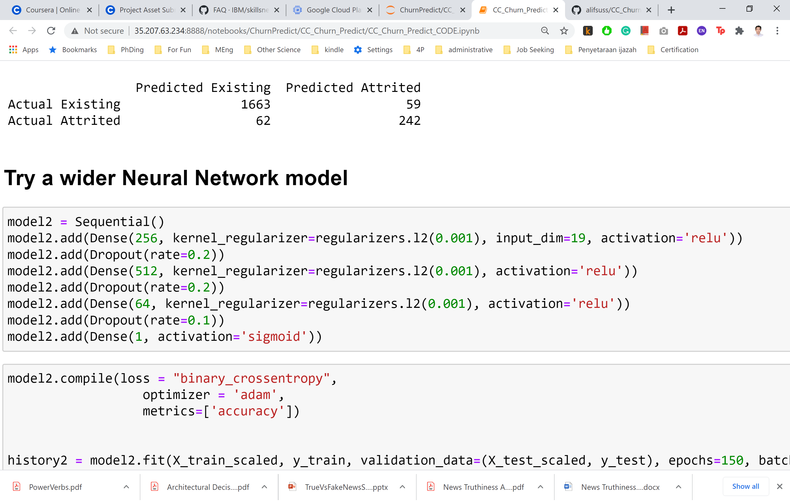
Neural Network (NN)
Long NN
Wide NN

Slide 14
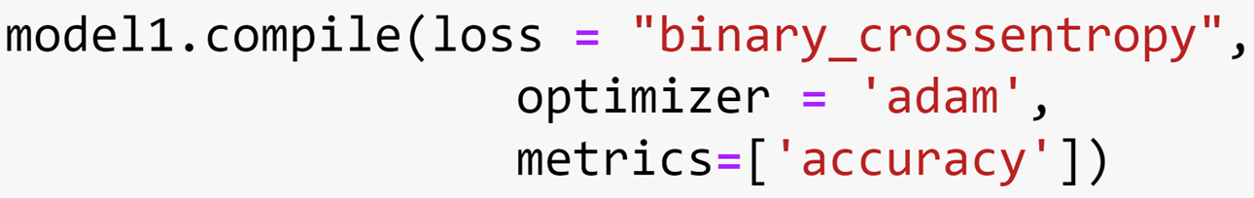
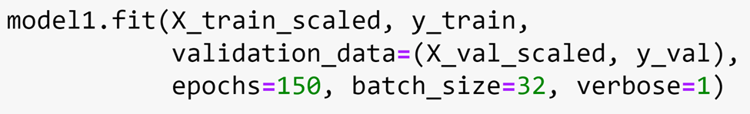
Neural Network (NN)
Optimizer: adam → fast and efficient!
Fit!

Slide 15
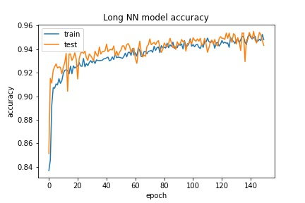
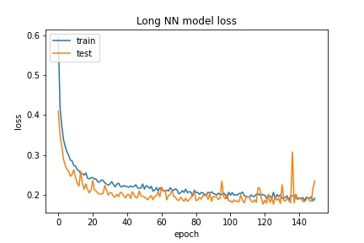
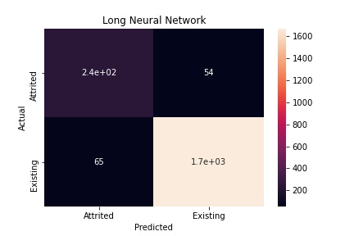
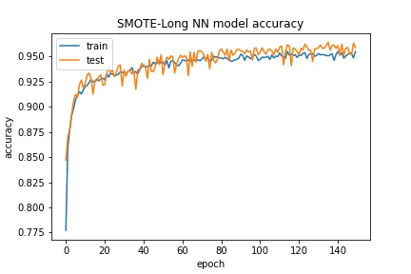
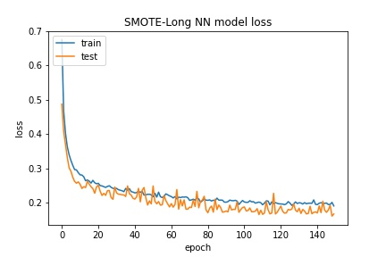
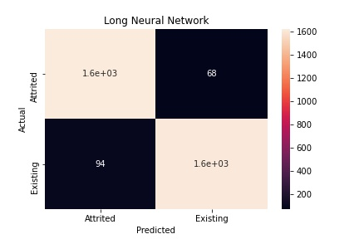
Long Neural Network (NN)
Original
SMOTE

Slide 16
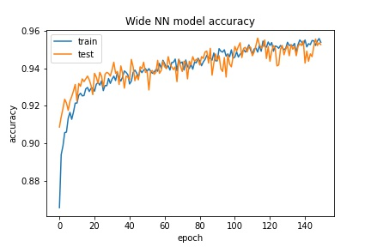
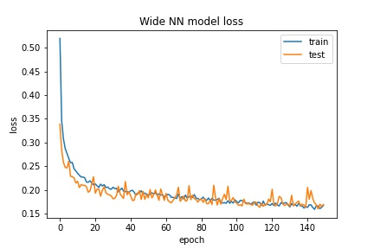
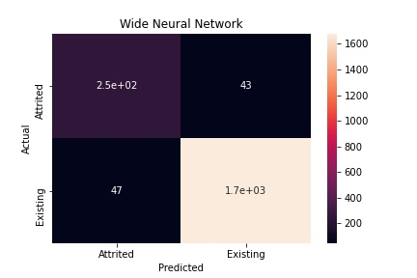
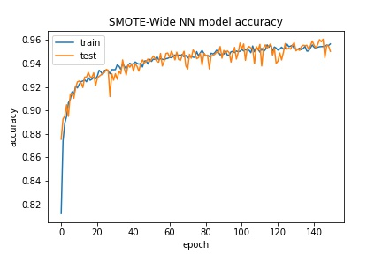
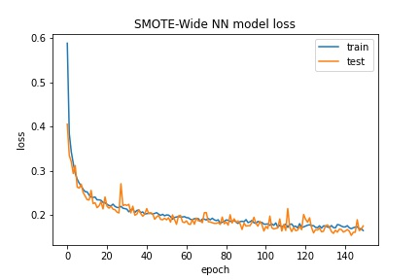
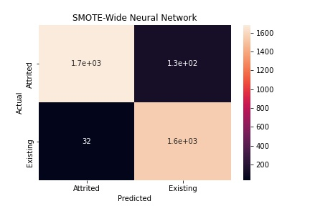
Wide Neural Network (NN)
Original
SMOTE

Slide 17
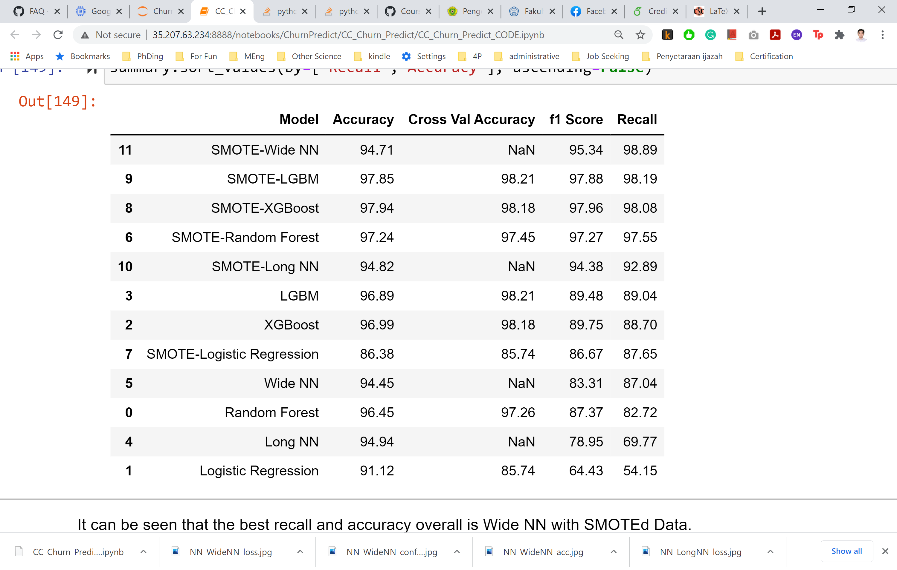
Summary
Over-sampling is important!
Significantly Improve Parameters
Use SMOTE please!
XGBoost work best
~98% in all Accuracy, F1 and Recall
Wide NN work better than Long:
~95% Accuracy & F1, and 99% in Recall
Prediction of churn can be done using:
LGBM or Wide Neural Network.
Get your promo and business strategy!

Slide 18
Thank You!

